Slide 1

Room Occupancy
Presented by:
Abdul Rauf
Naveed Manzoor Afridi (5149575)

Slide 2
Content
Problem statement.
Dataset
Pre-processing:
Correlation b/w the variables.
Detection & removal of outliers.
Difference of states.
Normalization.
Basic models training.
Evaluation & Best model selection.
Hyperparameter tuning.
Retraining
Feature Importance
Conclusion.

Slide 3
Problem Statement
There are some use-cases:
Security issue.
Hotel Management.
Tenant Management.
Health Purpose.
Mapping and localization (robotics case)

Slide 4
Dataset
Characteristics | Detail
Number of rows | 2665
Null-Parameter | N/A
All Columns Data-Type | Real (float64)
Dataset Type | Multivariate
Associated Tasks | Classification
We have 5 feature columns:
Temperature: unit is Celsius
Humidity: Relative Humidity in %
CO2: unit is PPM
Light: unit is LUX
Humidity Ratio: is a derived quantity from temperature and relative humidity
Target Variable:
Occupancy: 1 - Room is occupied. 0 - Room is empty.

Slide 5
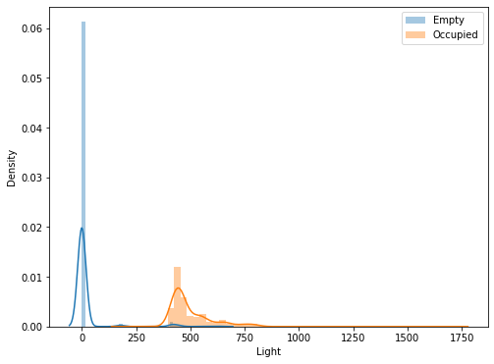
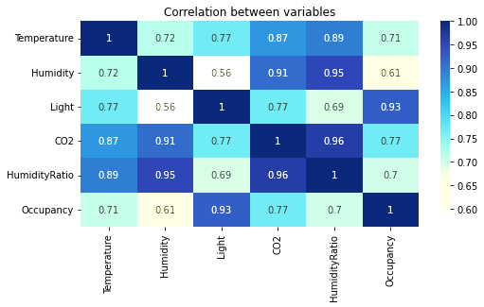
Pre-Processing
. Correlation b/w the variables:
Light is a highly correlated variable with occupancy. As compared to other features.

Slide 6
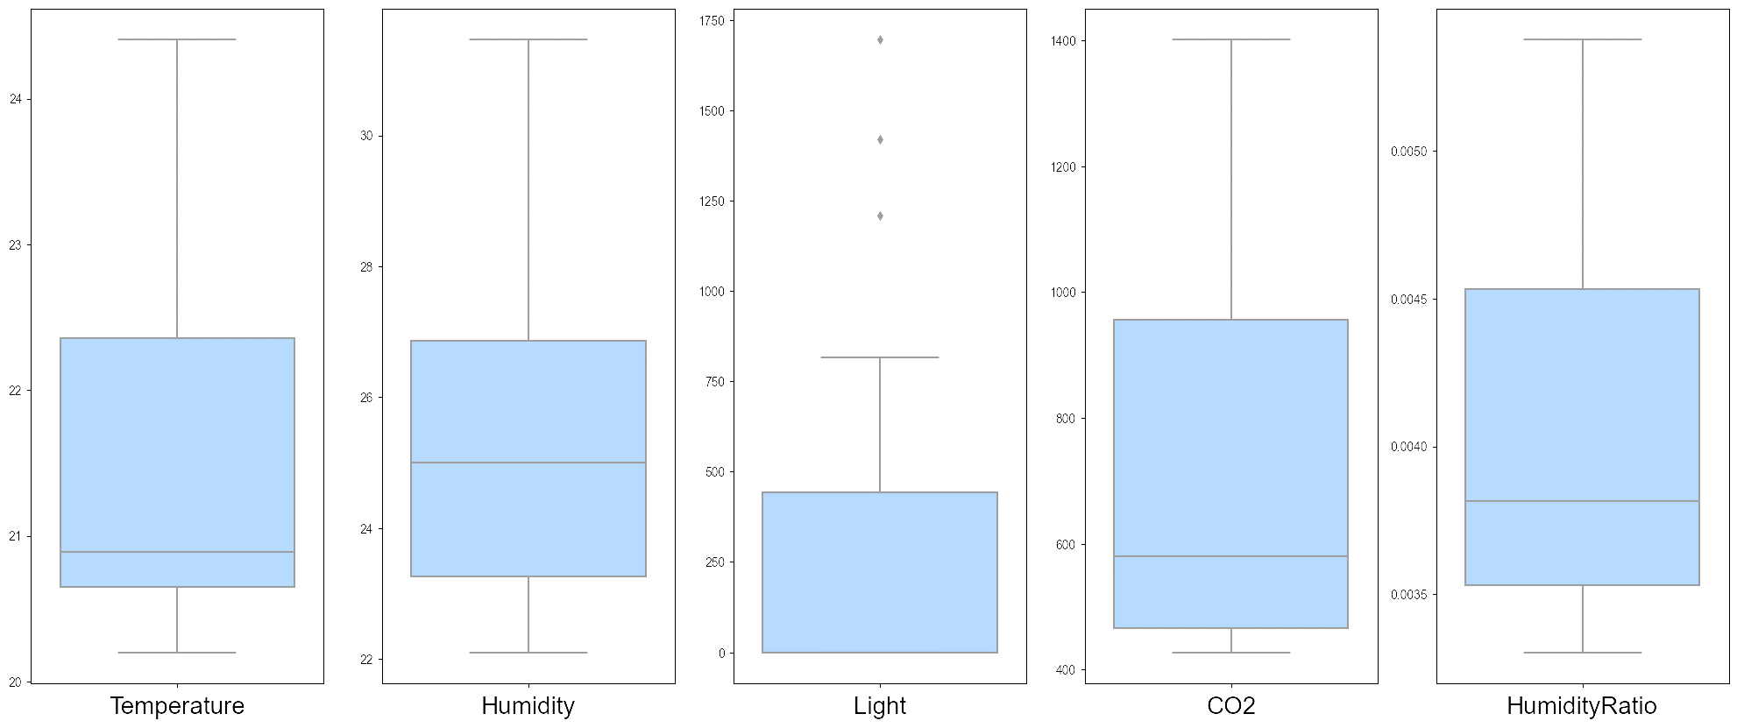
Pre-Processing
Detection & removal of outliers:
3 values were detected as outliers in the light sensor data.

Slide 7
Pre-Processing
3. Difference of states:
Before and After cleaning the outliers
For Light Feature:
Observation | Before | After
Count | 2665.000000 | 2662.000000
Mean | 193.227556 | 191.820017
Std | 250.210906 | 246.719570
Max Value | 1697.250000 | 817.000000

Slide 8
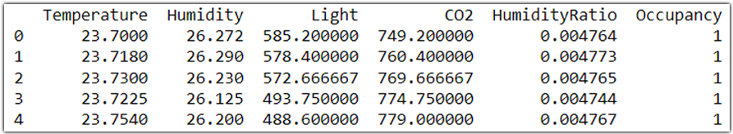
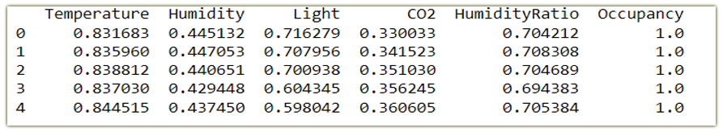
Pre-Processing
4. Normalization:
We assume that some of the Algorithm expect a normalized dataset like in our case:
Logistic Regression
SVM
Note: In the end, we try to compare the results with/without normalization to understand the effect.

Slide 9
Basic Model Training
 | Predicted No | Predicted Yes
Actual No | 329 | 8
Actual Yes | 0 | 196
Decision Tree:
Hyper-Parameter:
Max Depth = 4
Random Forest:
Hyper-Parameter:
Max Depth = 4
N_Estimator = 2500
Note: We select the parameter by manual tuning, to avoid complexity.
 | Predicted No | Predicted Yes
Actual No | 329 | 8
Actual Yes | 0 | 196

Slide 10
Basic Model Training
3. K-Neighbor:
Hyper-Parameter:
N_Neighbors = 7
4. Support Vector Classifier:
Both confusion matrices are the same with or without normalized data
5. Logistic Regression:
Both confusion matrices are the same with or without normalized data
 | Predicted No | Predicted Yes
Actual No | 334 | 3
Actual Yes | 5 | 191
 | Predicted No | Predicted Yes
Actual No | 328 | 9
Actual Yes | 0 | 196
 | Predicted No | Predicted Yes
Actual No | 328 | 9
Actual Yes | 0 | 196

Slide 11
Evaluation & Best model selection
We can see that the decision tree has the highest metrics values (Accuracy score and F1)
No | Model | Accuracy Score | Recall | F1score
1 | Decision Tree Classifier | 0.986867 | 1.000000 | 0.982456
2 | KNeighbors Classifier | 0.986867 | 0.989796 | 0.982278
3 | Random Forest Classifier | 0.984991 | 1.000000 | 0.980000
4 | SVC | 0.983114 | 1.000000 | 0.977556
5 | SVC (normalized) | 0.983114 | 1.000000 | 0.977556
6 | Logistic Regression | 0.983114 | 1.000000 | 0.977556
7 | Logistic Regression (normalized) | 0.983114 | 1.000000 | 0.977556

Slide 12
Hyper-Parameter Tuning: (Cross-Validation)
Grid Search with Cross-Validation:
Uses a different combination to get the best parameters
Hyper-Parameter | Values
Criterion | Gini and Entropy
Max Depth | Range from 1 to 10
Min Samples Split | Range from 1 to 10
Min Samples leaf | Range from 1 to 5

Slide 13
Hyper-Parameter Tuning: (Cross-Validation)
Best hyper-parameters are:
Best Hyper-Parameter | Values
Criterion | Gini
Max Depth | 7
Min Samples Split | 3
Min Samples leaf | 1

Slide 14
Re-Training (with the best hyper-params)
Decision Tree (Before):
Hyper-Parameter:
Max Depth = 4
Decision Tree (with best params) :
Hyper-Parameter:
Max Depth = 4
Criterion = Gini
Min Samples Split = 3
Min Samples leaf = 1
Confusion Matrices:
 | Predicted No | Predicted Yes
Actual No | 330 | 7
Actual Yes | 0 | 196
 | Predicted No | Predicted Yes
Actual No | 332 | 5
Actual Yes | 1 | 195

Slide 15
Feature Importance
We noticed in the beginning that LIGHT is the most important feature in our case.
Feature | Score
Light | 0.946238
CO2 | 0.032038
Temperature | 0.013231
Humidity | 0.008493
HumidityRatio | 0.000000

Slide 16
Conclusion
Meaningful Results:
The chosen model was Decision Tree Classification since it´s the most accurate, and got a perfect accuracy.
Removing outliers creates a little effect:
IQR-based filtering is better than the Percentile in our case.
Through the analysis of feature importance, we can assume that Light is the most important feature of classification.
Non-Meaningful Results:
Normalization: We didn’t notice the big change after normalization.
No change in results with standardization and normalization.

